Slide 1
System Strength Overview
Aryan Ritwajeet Jha
Intern (Summer 2024)
Advanced System Analytics & Modelling (ASAM)
NERC

Slide 2
Objective
With the greatly expanded share of renewable in power generation, IBRs along with other components and new control schemes are being used in the modern power grid at an unprecedented scale.
Issues at various scales are being observed, which may be at least partially associated with the current implementation of IBRs [odessa22, southtexas24]
We know the symptoms, but we don’t know a systematic diagnosis. So, people have come up with the concept System Strength which will help investigate and fix these symptoms (ideally before they ever even occur).

Slide 3
Objective
Starter questions:
How to measure system strength (SS) of a system?
What are the various kinds of issues observed when SS is low?
How to model SS with increasing complexity due to increasing number of generators in the grid?
How to provide SS through generators and inverters using new technologies?

Slide 4
System Strength – Preliminary Definition
System Strength – AEMO understands it as the Ability of a system to maintain its Voltage (waveform and phase angle) [AEMO-SS-Brief]
How exactly (mathematically)? – A concrete metric not seen by me yet. AEMO’s guidelines have been banking on Available Fault Level (AFL).
Voltage where exactly? – Not Mathematically specified. All documents I’ve read seem to focus more on some local voltage as opposed to a particular voltage (PoI, node voltage, bus voltage, etc.)
Current ‘metric’ is basically a holistic combination of Available Fault Level and IBR Stability Criteria.

Slide 5
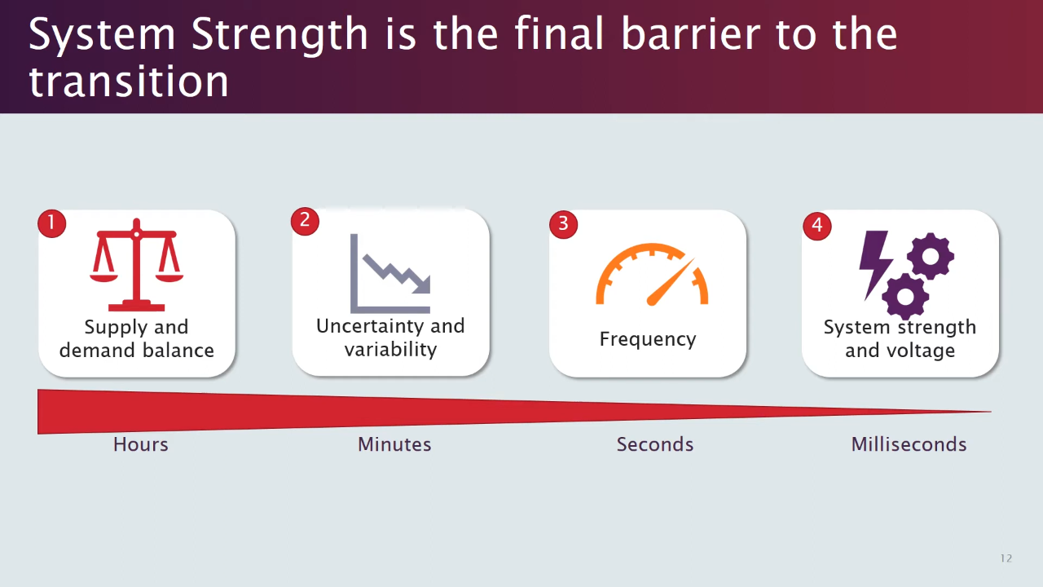
System Strength - Motivation
[session01]

Slide 6
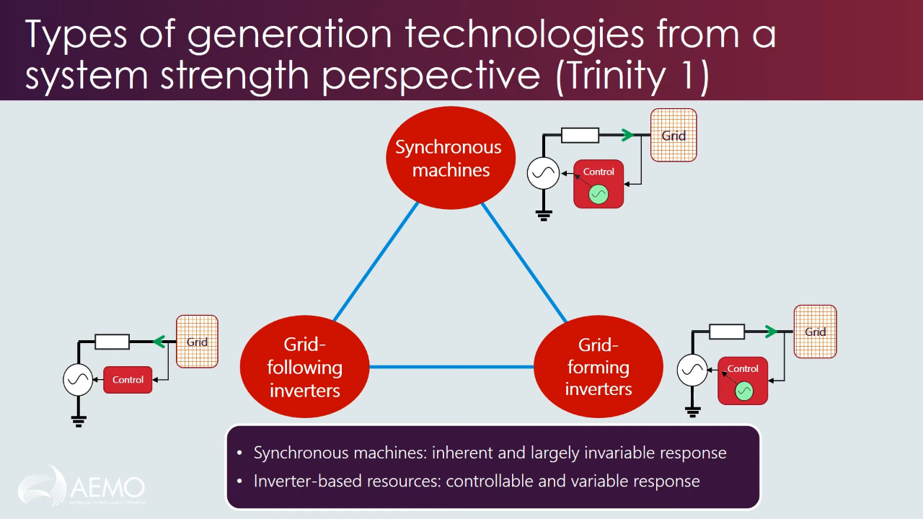
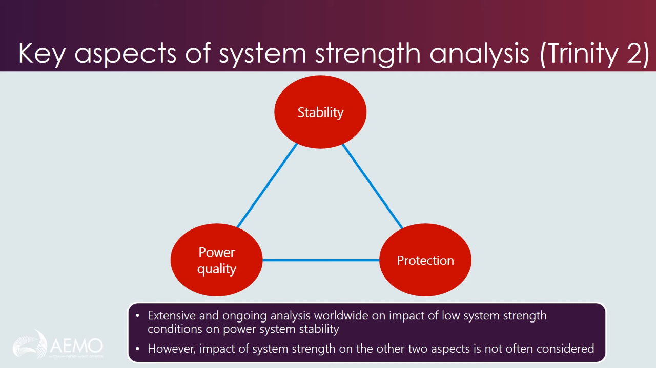
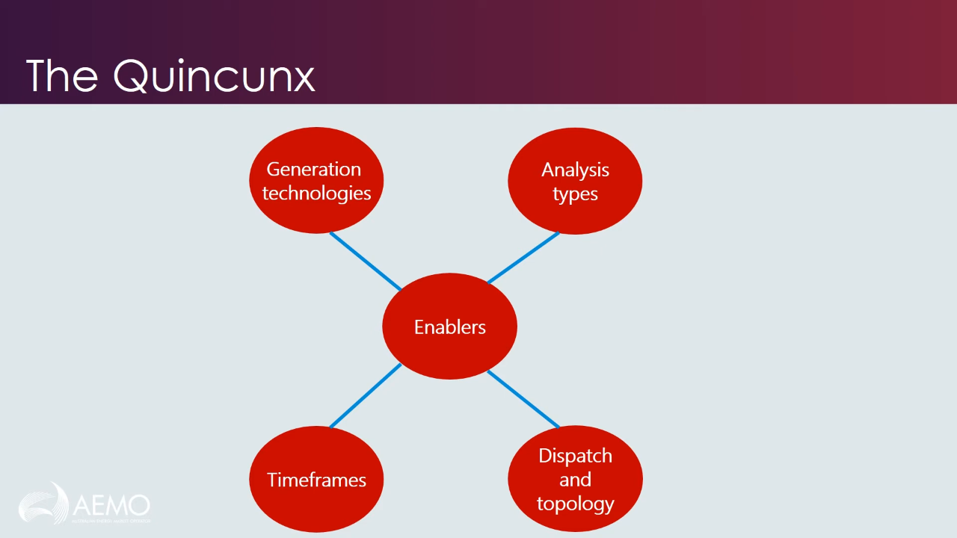
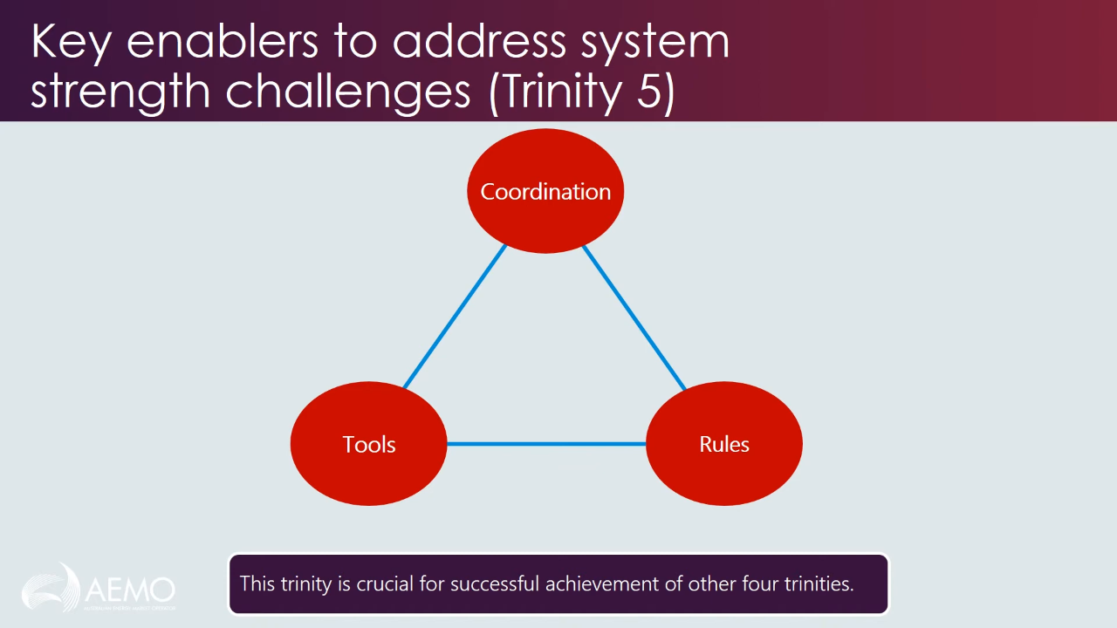
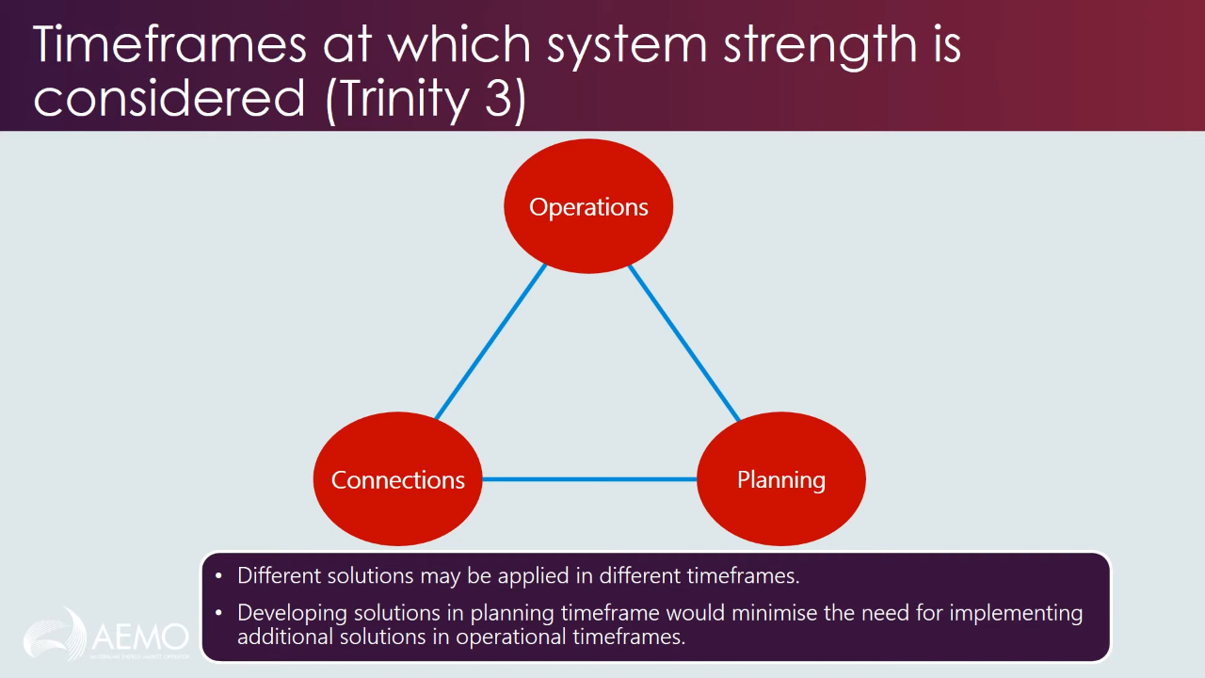
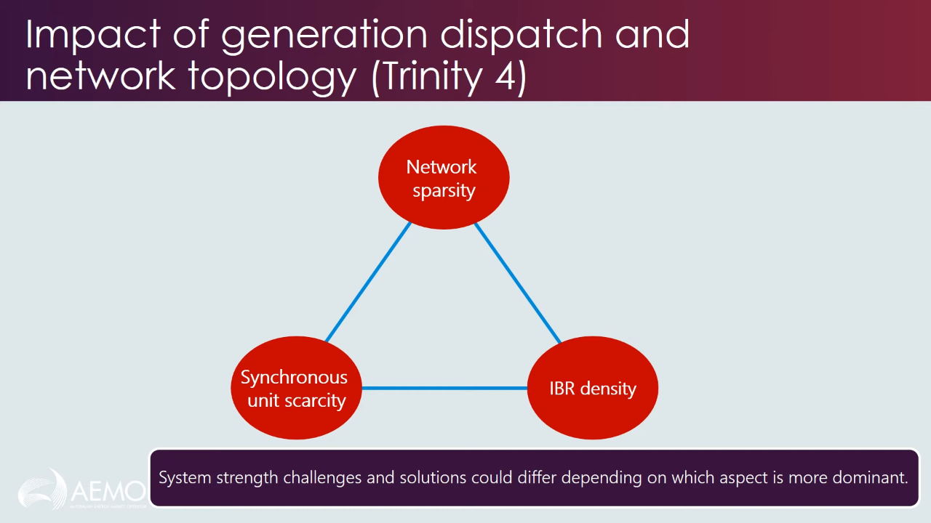
System Strength - Classification
Babak Badrzadeh from AEMO has classified System Strength into five aspects (a ‘quincunx’ : set of five).
Each aspect itself is a trinity of approaches.
[session01]

Slide 7
System Strength - Classification
Generation Technologies
[session01]

Slide 8
System Strength - Classification
Analysis Types
[session01]

Slide 9
System Strength - Classification
Timeframes
[session01]

Slide 10
System Strength - Classification
Dispatch and Topology
[session01]

Slide 11
System Strength - Classification
Key Enablers
[session01]

Slide 12
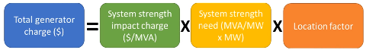
System Strength - Incentivization
Proposed Market Incentivization for Injecting System Strength into the grid for GOs
[session01]

Slide 13
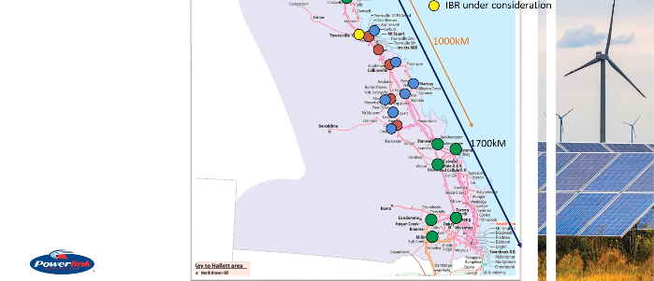
Industry Example 1: GO’s ‘Do No Harm’ responsibility, PIA, FIA
Queensland (QLD) Power Grid
[session02]

Slide 14
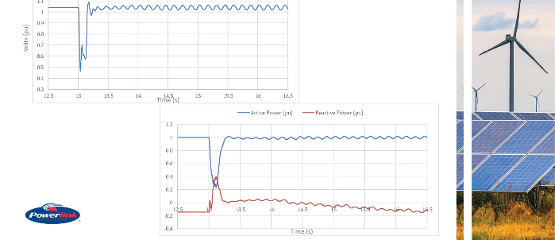
Industry Example 1: GO’s ‘Do No Harm’ responsibility, PIA, FIA
Fault simulated somewhere else in the grid, and its impact on the PoI of the proposed IBR seen.
V @ PoI without SS Adverse Impact Mitigation
P, Q @ PoI without SS Adverse Impact Mitigation
[session02]

Slide 15
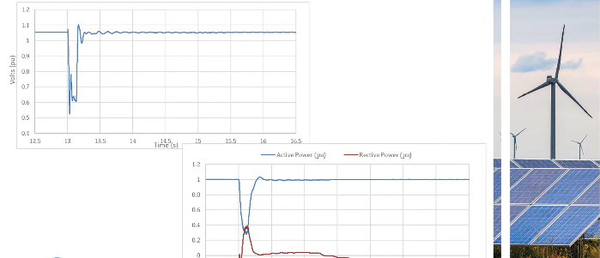
Industry Example 1: GO’s ‘Do No Harm’ responsibility, PIA, FIA
Fault simulated somewhere else in the grid, and its impact on the PoI of the proposed IBR seen.
V @ PoI with SS Adverse Impact Mitigation
P, Q @ PoI with SS Adverse Impact Mitigation
[session02]

Slide 16
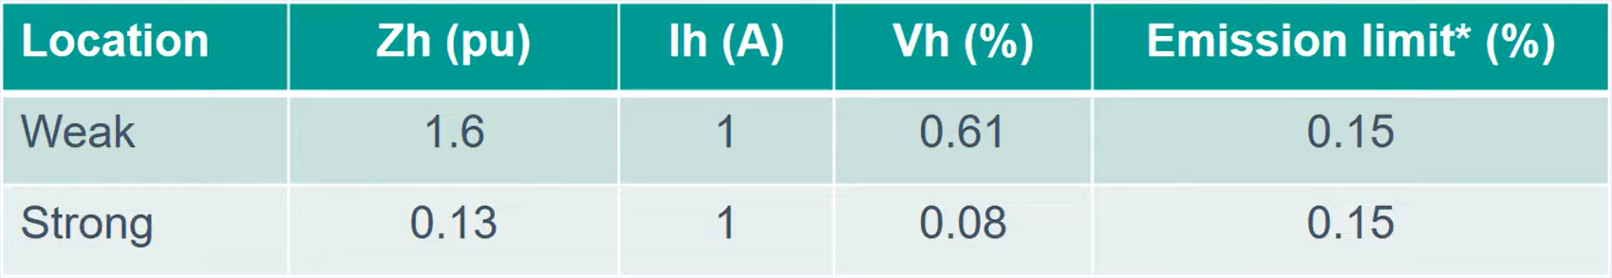
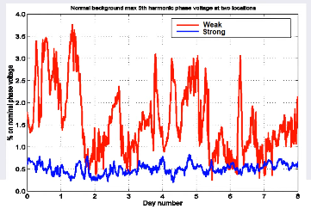
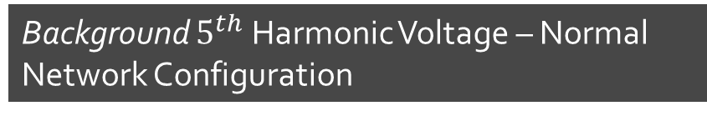
Industry Example 2: Harmonic Distortion due to Shunt Reactive Plant Switching
Weakness of SS causes high 5th harmonic distortion in Voltage
Background $5^{th}$ Harmonic Voltage – Normal Network Configuration
Weaker grids have higher harmonic impedance, which amplify even smaller harmonic currents as a bigger harmonic voltage.
Higher Harmonics not due to any forced oscillation at the PoI, but due to background natural harmonics in the network
Fluctuation in Harmonic Voltage due to various switching in and out of shunt reactive plants
[session02]

Slide 17
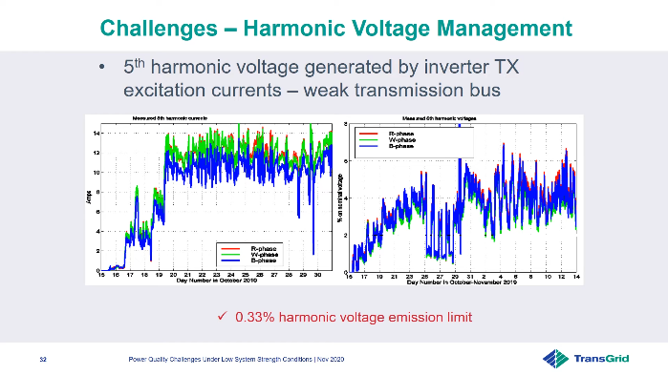
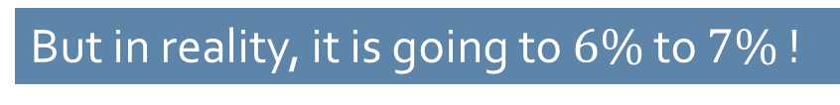
Industry Example 2 : Harmonic Distortion due to Inverter Transformer Excitation Current
Weakness of SS causes high 5th harmonic distortion in Voltage
Harmonic Voltage Emission Limit in $5^{th}$ Harmonic of Bus Voltage is set at $0.33$%
But in reality, it is going to $6\%$ to $7\%$ !
[session02]

Slide 18
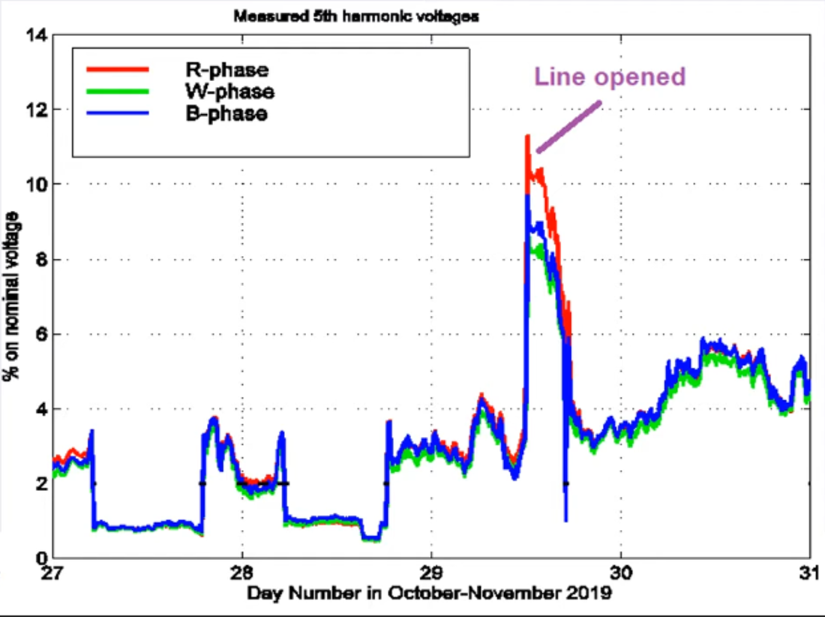
Industry Example 2 : Harmonic Distortion due to Weakened Topology
Harmonic Voltage at a weak bus shoots up when one of the connected lines is opened (network topology slightly weakened)
[session02]

Slide 19
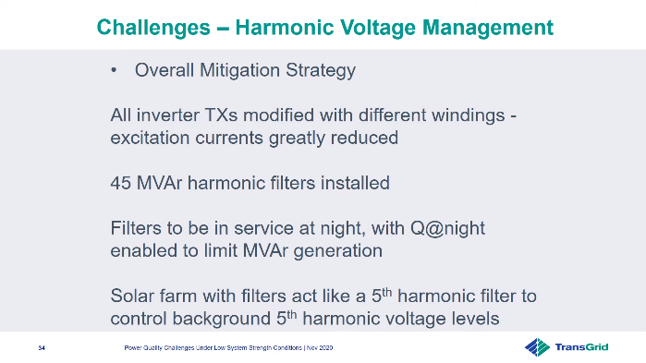

Industry Example 2: How to counter these Power Quality ($5^{th}$ Harmonic) Issues?
[session02]

Slide 20
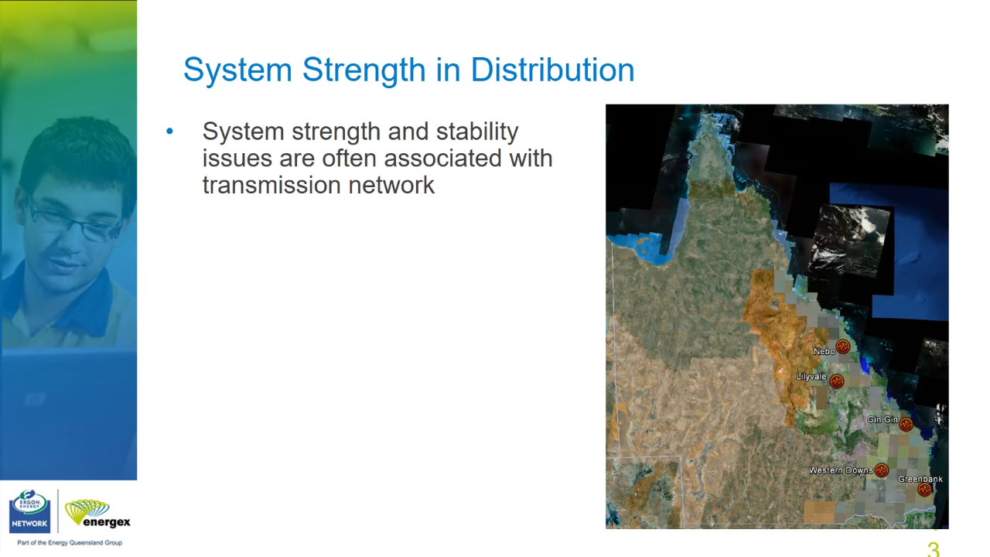
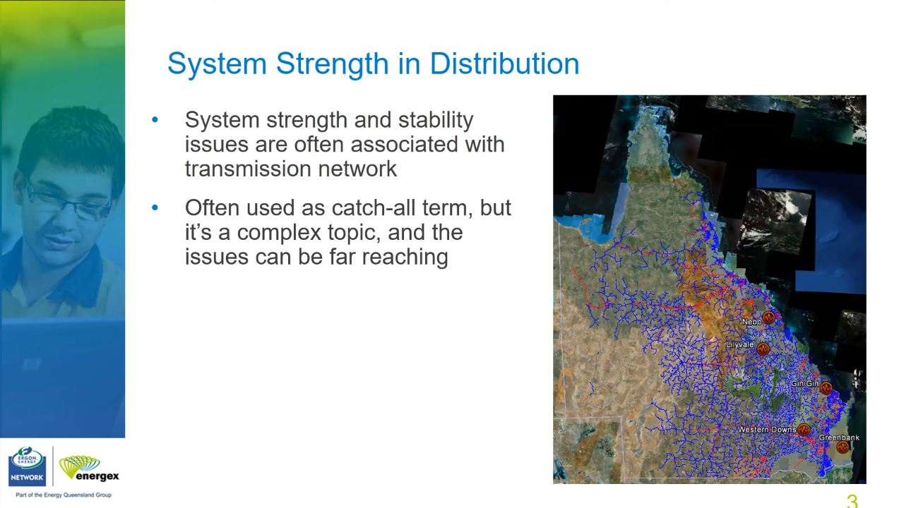
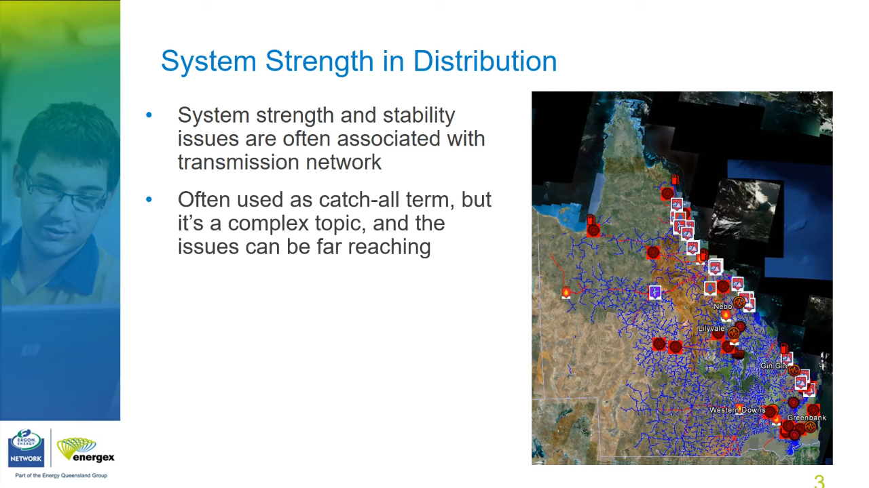
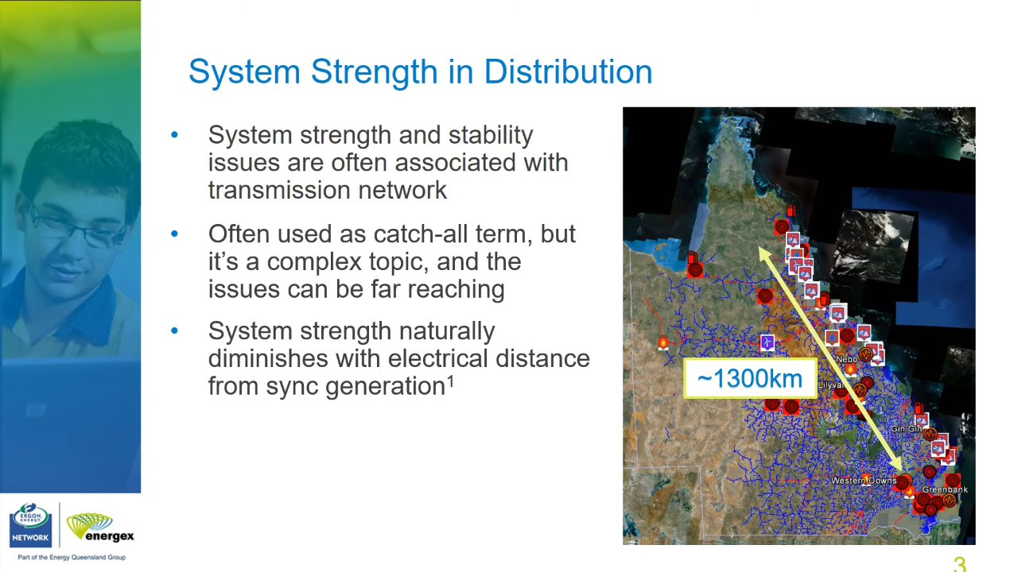
Industry Example 4
Queensland (QLD) Power Grid
A: SGs along the coast
B: A + Sub-tlines (red) and Dist lines (blue)
C: B + Renewables
C: Distance between SGs and Renewables
[session02]
System Strength naturally diminishes with electrical distance from SGs [ARENA2020]

Slide 21
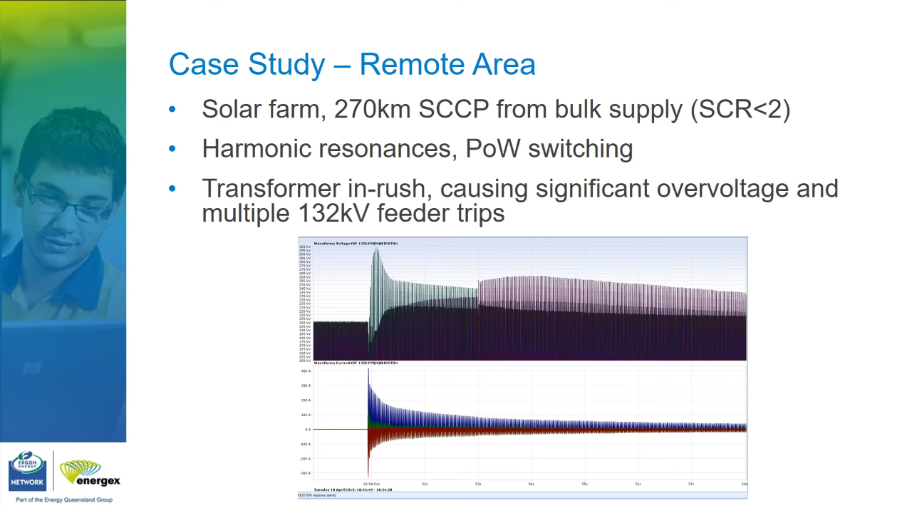
Industry Simulation Example 3
Later
[session02]

Slide 22
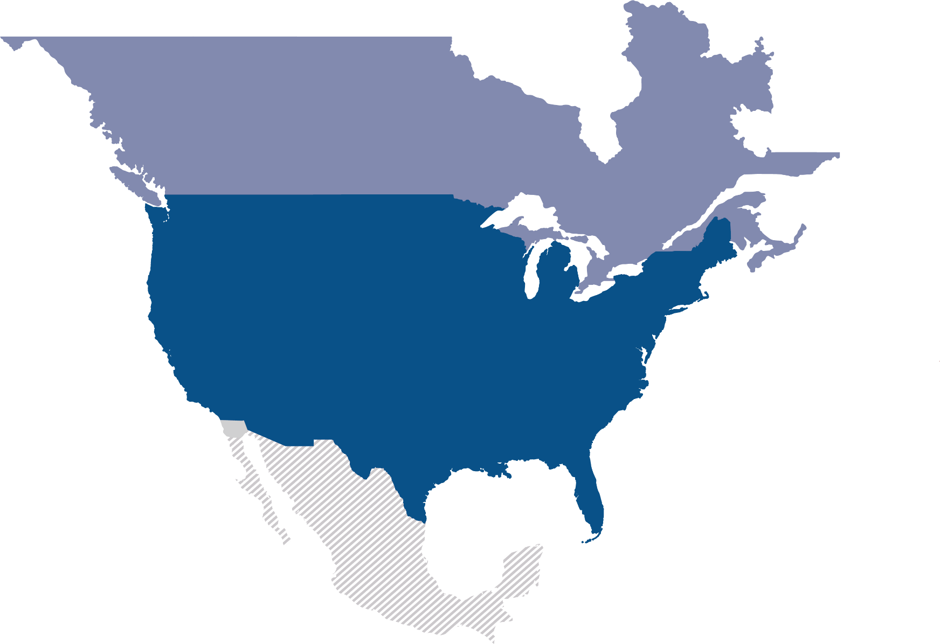
Latest Slides End. Previous Slides Follow.

Slide 23
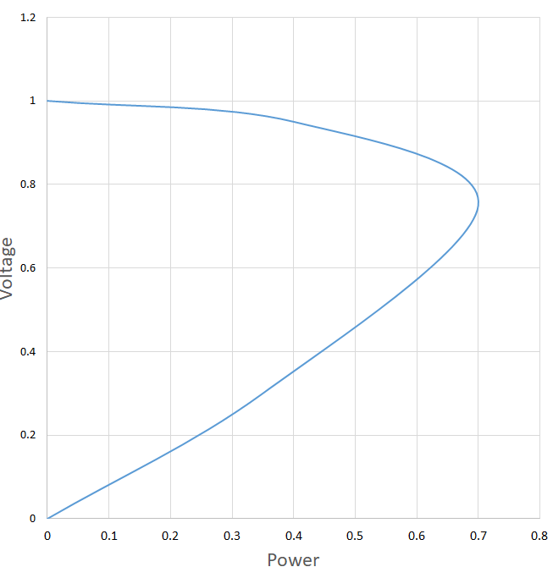
PV Curve
wrt changing balance point of real power at the node
Normally PV Continuation curves [PVCurve] are studied for load buses to study effect of nodal voltage due to load demand (Real) power.

Slide 24
References
[odessa22] RSTC_Reliability_Guidelines - All Documents. (2024, June 21). Retrieved from https://www.nerc.com/comm/RSTC_Reliability_Guidelines/Forms/AllItems.aspx
[southtexas24] South Texas Wind Events_03082024.pptx. (2024, June 21). Retrieved from https://view.officeapps.live.com/op/view.aspx?src=https%3A%2F%2Fwww.ercot.com%2Ffiles%2Fdocs%2F2024%2F03%2F06%2FSouth%2520Texas%2520Wind%2520Events_03082024.pptx&wdOrigin=BROWSELINK
[PVCurve] Contributors to Wikimedia projects. (2023, December 16). Power-voltage curve - Wikipedia. Retrieved from https://en.wikipedia.org/w/index.php?title=Power-voltage_curve&oldid=1190109767
[cigre-SS-YT-20] CIGRE Australia. (2024, June 21). AEMO/CIGRE System Strength Workshop Nov 2020. Youtube. Retrieved from https://www.youtube.com/playlist?list=PLwGHigN9C41BaJhk_rfXeoT8e67-m4aDX
[cigre-SS-Workshop-Iti]
[aemo-SS-explain
[cigre-SS-Brief-2021] Chair, B. B. (.- C4. 5. C. a. Z. E. (.- S. C. (2021). System Strength. CIGRE. Retrieved from https://www.cigre.org/article/GB/publications/reference-papers/system-strength

Slide 25
References
[ARENA2020] Managing System Strength During the Transition to Renewables. (2020, August 03). Retrieved from https://arena.gov.au/knowledge-bank/managing-system-strength-during-the-transition-to-renewables

